Slide 1
On the Capacity Scalability of Line Networks with Buffer Size Constraints
Prof. Shenghao Yang, Jie Wang, Yanyan Dong, Yiheng Zhang
The Chinese University of Hong Kong, Shenzhen
ISIT
July 2019
Slides available on the link https://walterbabyrudin.github.io

Slide 2

Why Multi-hop Line Networks?
Notes:
IoT setting, tend to use small devices in cellular network. Study line network first.
Transmission through long distance is hard, possible solution is multi-hop networks.

Slide 3
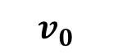
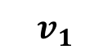
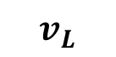

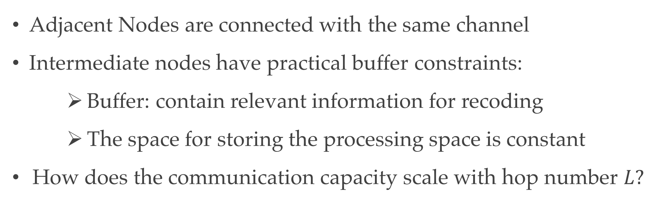
Problem Setup
Consider a line network with $L$ hops:
$$v_{0}$$
$$v_{1}$$
$$v_{L}$$
Zero-error Capacity is zero
Adjacent Nodes are connected with the same channel
Intermediate nodes have practical buffer constraints:
Buffer: contain relevant information for recoding
The space for storing the processing space is constant
How does the communication capacity scale with hop number $L?$
Notes:
Send message from v0 to vL, through multi-hop line networks. Several assumptions are made:
For simplicity, assume that adjacent nodes are connected with the same channel.
Here the buffer means that the intermediate nodes need to store relevant information for recoding.
We assume the space for storing the processing space is constant, while we care about active storage that is retrived from inputs from channel (v_{i-1},v_i)
Communication capacity scale with hop number L.

Slide 4
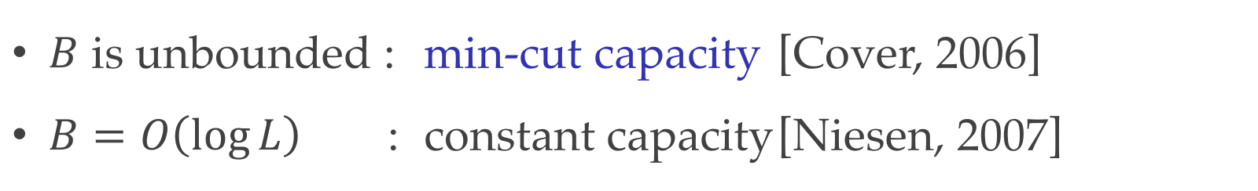
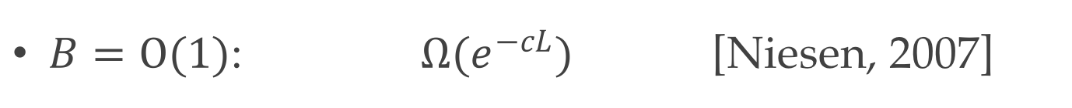
Related Work
Consider a line network with $L$ hops with Buffer Size $B$
$$v_{0}$$
$$v_{1}$$
$$v_{L}$$
How does the communication capacity scale with hop number $L?$
$B$ is unbounded : min-cut capacity [Cover, 2006]
$B=O\left(\log{L}\right)$ : constant capacity [Niesen, 2007]
$B=O(1)$: $Ω(e^{−cL})$ [Niesen, 2007]
Notes:
Question is interesting, but not so many works concern this question.
Two kinds of assumptions on the buffer size when the capacity is bounded away from 0,as L goes to infinite
Unfortunately, when buffer is finite, recent results gives a lower bound for the the capacity, which decreases to 0 exponentially fast.
Also, the converse for the case B=O(1) is unknown, i.e., we don’t know whether the capacity really converges to 0 as L goes to infinite.

Slide 5
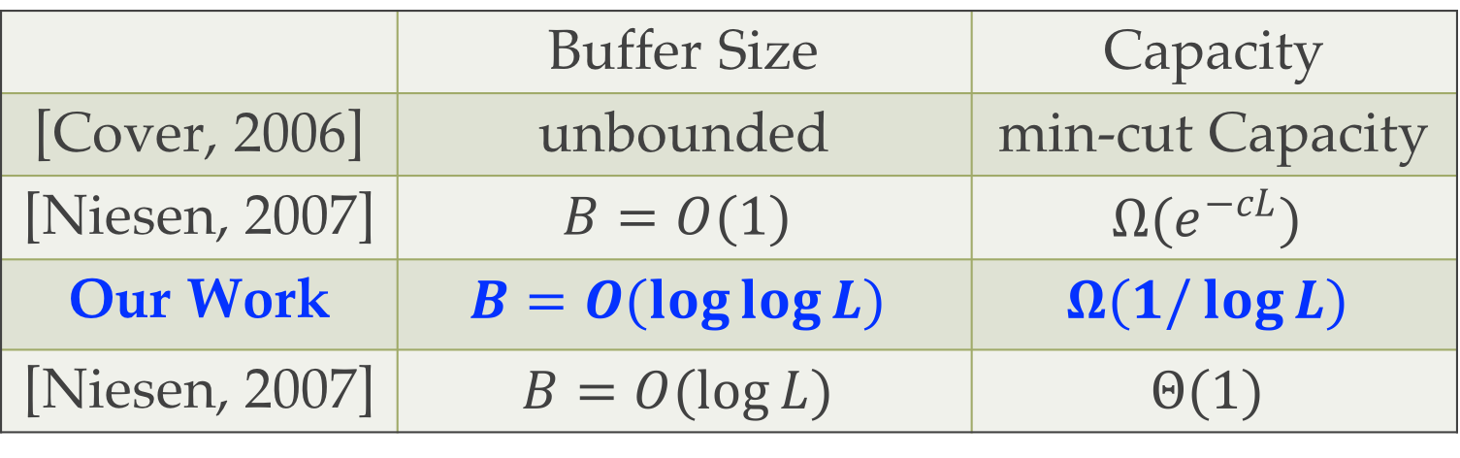
Main Result
Consider a line network with $L$ hops with Buffer Size $B$
$$v_{0}$$
$$v_{1}$$
$$v_{L}$$
How does the communication capacity scale with hop number $L?$
 | Buffer Size | Capacity
[Cover, 2006] | unbounded | min-cut Capacity
[Niesen, 2007] | $$B=O(1)$$ | $$Ω(e^{−cL})$$
Our Work | $$B=O(\log{\log{L}})$$ | $$Ω(1/\log{L})$$
[Niesen, 2007] | $$B=O(\log{L})$$ | $$Θ(1)$$
Notes:
In our work, we shows that when B scales with L with order loglog L, the capacity is lower bounded by 1/log L, which also converges to 0. But the convergence rate is very slow.

Slide 6
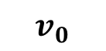
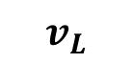
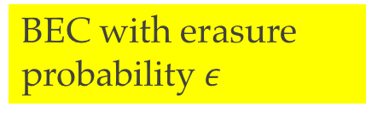
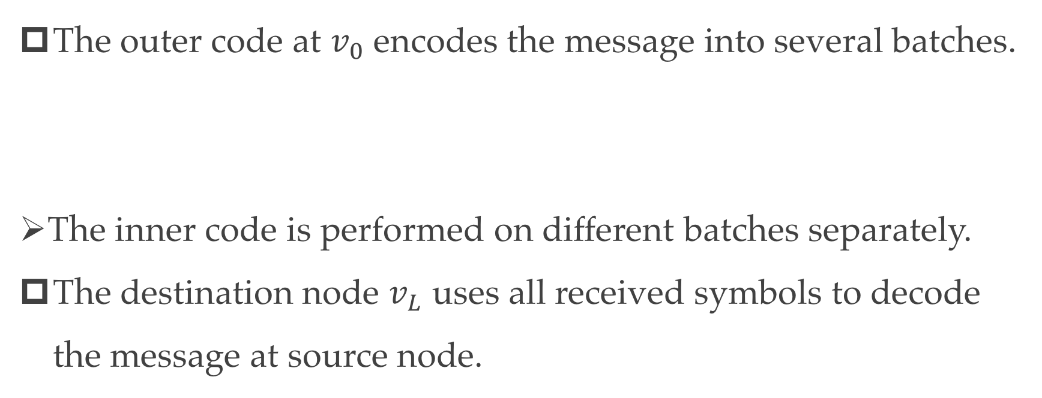
Batched Code for Line Networks of BEC
BEC with erasure probability $ε$
$$v_{0}$$
$$v_{1}$$
$$v_{L}$$
The batched code contains an outer code and an inner code:
The outer code at $v_{0}$ encodes the message into several batches.
The inner code is performed on different batches separately.
The destination node $v_{L}$ uses all received symbols to decode the message at source node.
Notes:
Inner code consists of repetition codes for the erasure channel;
The outer code is an erasure correction code;
1. The source node v0 transmits the symbol N times through the channel (v0, v1).
2. Intermediate nodes tries to recover the symbol x from the N outputs from (vi−1 , vi ).
3. If successful, node vi transmits the recovered symbol N times through the channel (vi , vi+1)

Slide 7
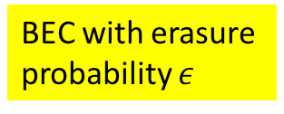
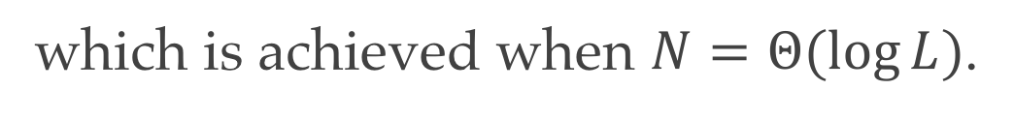
Performance of proposed Code for Line Networks of BEC
$$v_{0}$$
BEC with erasure probability $ε$
$$v_{1}$$
$$v_{L}$$
The destination node $v_{L}$ can recover the message with probability
The achievable rate of our coding scheme is
The best performance of our coding scheme should be
which is achieved when $N=Θ(\log{L})$.

Slide 8
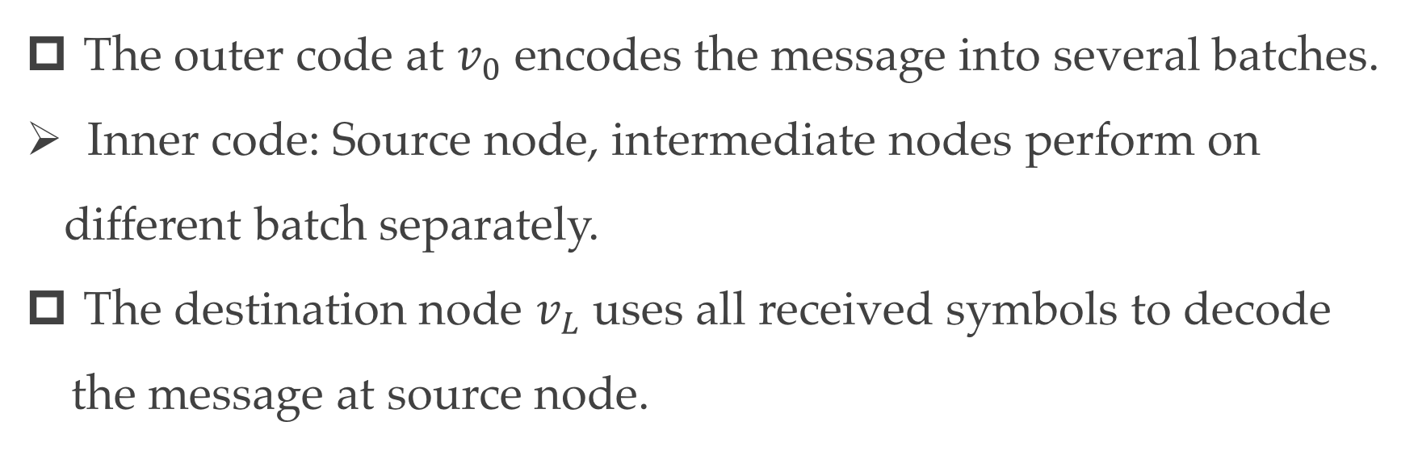
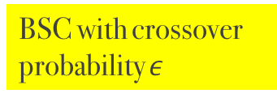
Batched Code for Line Networks of BSC
BSC with crossover probability $ε$
$$v_{0}$$
$$v_{1}$$
$$v_{L}$$
Inner code: repetition codes for BSC;
Outer code: capacity achieving code for BSCs
The outer code at $v_{0}$ encodes the message into several batches.
Inner code: Source node, intermediate nodes perform on different batch separately.
The destination node $v_{L}$ uses all received symbols to decode the message at source node.

Slide 9
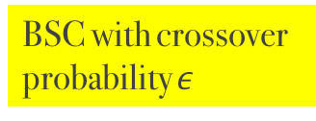
Performance of proposed Code for Line Networks of BSC
$$v_{0}$$
BSC with crossover probability $ε$
$$v_{1}$$
$$v_{L}$$
The transmission between adjacent nodes can be viewed as a new BSC:
The transmission from $v_{0}$ to $v_{L}$ is the $L$-concatenation of $\tilde{Q}$:
The achievable rate of our coding scheme is

Slide 10
Best Performance of proposed Code for Line Networks of BSC (I)
$$v_{0}$$
BSC with crossover probability $ε$
$$v_{1}$$
$$v_{L}$$
The best performance of our coding scheme should be
Global quadratic lower bound by Taylor Expansion:

Slide 11
Best Performance of proposed Code for Line Networks of BSC (II)
$$v_{0}$$
BSC with crossover probability $ε$
$$v_{1}$$
$$v_{L}$$
The lower bound for the optimization problem should be
Or equivalently,

Slide 12
Best Performance of proposed Code for Line Networks of BSC (III)
$$v_{0}$$
BSC with crossover probability $ε$
$$v_{1}$$
$$v_{L}$$
Apply the tail bound for cdf of binomial distribution:
This leads to a easy-solved optimization problem:

Slide 13
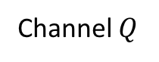
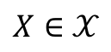
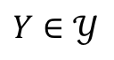
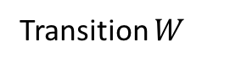
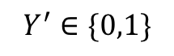
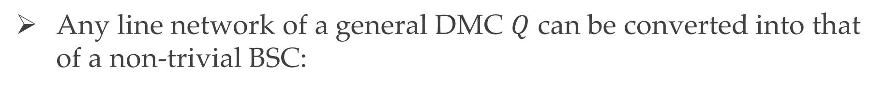
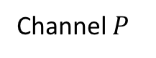
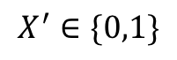
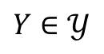
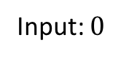
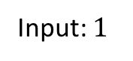
Generalizing into Line Networks of DMC
Any line network of a general DMC $Q$ can be converted into that of a non-trivial BSC:
Input: $0$
Input: $1$
$$X∈𝒳$$
$$Y∈𝒴$$
Channel $Q$
$$X^{′}∈\{0,1\}$$
$$Y∈𝒴$$
$$Y^{′}∈\{0,1\}$$
Channel $P$
Transition $W$

Slide 14
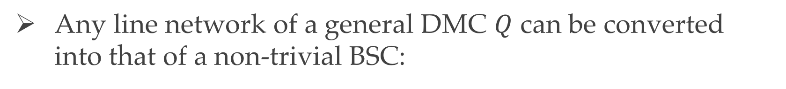
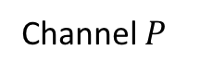
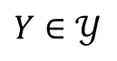
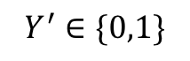
Generalizing into Line Networks of DMC
Any line network of a general DMC $Q$ can be converted into that of a non-trivial BSC:
$$X^{′}∈\{0,1\}$$
$$Y∈𝒴$$
$$Y^{′}∈\{0,1\}$$
Channel $P$
Transition $W$
The Channel $PW$ is the desired BSC with positive capacity

Slide 15
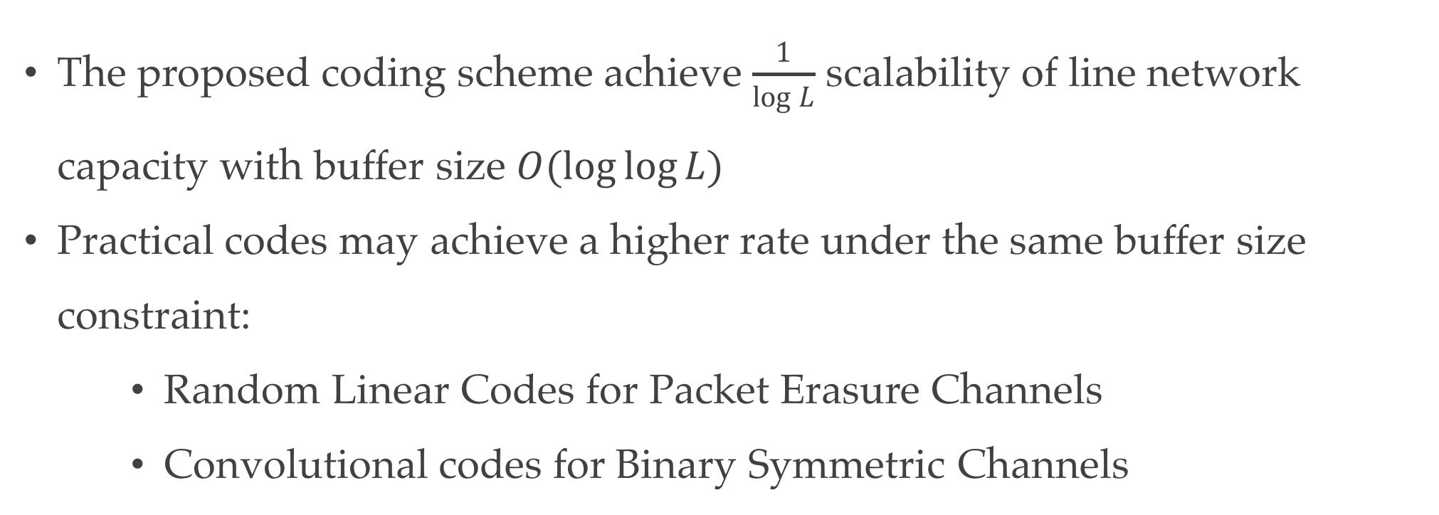
Remarks
The proposed coding scheme achieve $\frac{1}{\log{L}}$ scalability of line network capacity with buffer size $O(\log{\log{L}})$
Practical codes may achieve a higher rate under the same buffer size constraint:
Random Linear Codes for Packet Erasure Channels
Convolutional codes for Binary Symmetric Channels

Slide 16
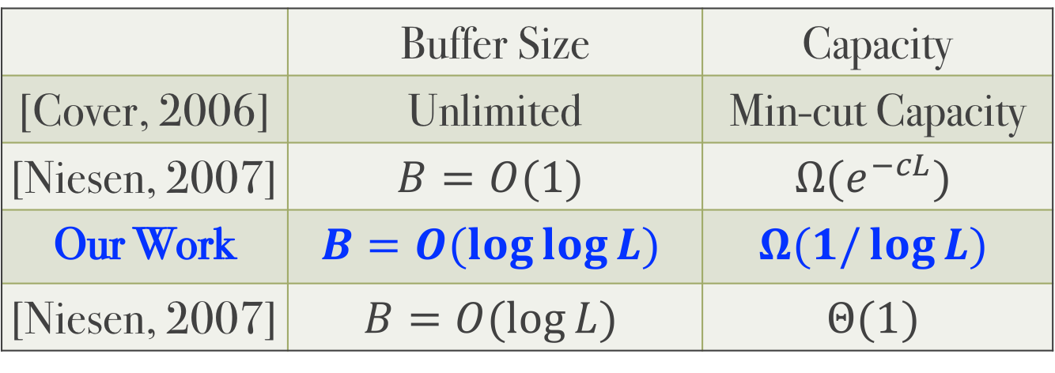
Future Study
Our Scalability Results can be extended into more general channels:
Continuous Channels
The Channel between adjacent nodes can be different
The channel can have memory
 | Buffer Size | Capacity
[Cover, 2006] | Unlimited | Min-cut Capacity
[Niesen, 2007] | $$B=O(1)$$ | $$Ω(e^{−cL})$$
Our Work | $$B=O(\log{\log{L}})$$ | $$Ω(1/\log{L})$$
[Niesen, 2007] | $$B=O(\log{L})$$ | $$Θ(1)$$

Slide 17
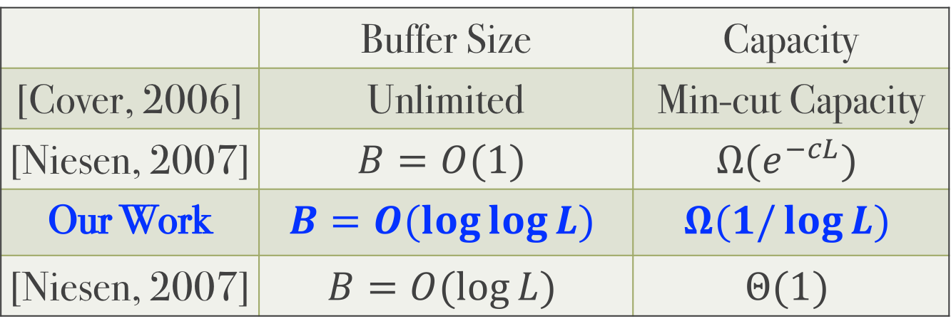
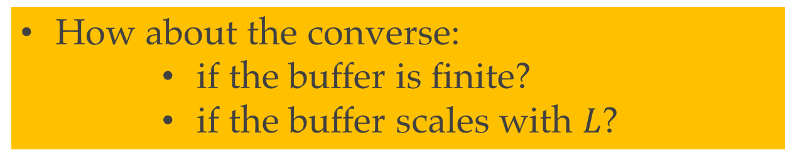
Future Study
We only give lower bound for capacity scalability results
How about the converse:
if the buffer is finite?
if the buffer scales with $L$?
 | Buffer Size | Capacity
[Cover, 2006] | Unlimited | Min-cut Capacity
[Niesen, 2007] | $$B=O(1)$$ | $$Ω(e^{−cL})$$
Our Work | $$B=O(\log{\log{L}})$$ | $$Ω(1/\log{L})$$
[Niesen, 2007] | $$B=O(\log{L})$$ | $$Θ(1)$$

Slide 18
Thanks!
ISIT
July 2019
Slides available on the link https://walterbabyrudin.github.io

